Slide 1

Paul Mendoza, www.PaulDMendoza.com
Notes:
Assuming you already have some sort of spatial data in your database or dataset. Maybe it’s points or polygons.
My demos in this presentation are using publicly available 2010 census data for California that you can download yourself and play with.

Slide 2

Geometry
  Introduced in SQL Server 2005
  Planar data (flat surface)
Geography
  Introduced in SQL Server 2008
  Terrestrial data (curved surfaces, earth)
Notes:
Geometry and Geography are two column data types.
Similarities
Stored as binary data
Both implement many of the same methods
Both data types are very common.
Geometry
Pros
Good for planar areas (flat surfaces).
Warehouse inventory tracking or spatial data at the city or state level
Conforms to Open Geospatial Consortium standards.
Cons
Harder to make work for the earth
Map splits are a problem for polygons.
Geography
Pros
Meant for round objects such as the earth.
Cons
Indexes can be an issues on tightly clustered data.
Does not fully conform to the Open Geospatial Consortium standards.

Slide 3

Geometry
  X, Y, SRID
Geography
  Latitude, Longitude, SRID
Notes:
For points, why not use Latitude and Longitude fields?
Difficult to query nearby locations from them.
Hard to index
Computing distance between two points is much more complex on the earth’s surface

Slide 4

Multiple points
Squares, triangles, or more complex shapes like US states.
Notes:
Limitations: A single polygon can’t be bigger than a single hemisphere. Meaning a single polygon can’t be bigger than one half of the earth’s surface. A single polygon can cross hemispheres though.
DEMO
Show US states

Slide 5

SRID
Identifies the coordinate system
Cannot compare two objects with different SRIDs
Notes:
DEMO
Show query to list out all of the SRIDs

Slide 6

SRID for earth
Earth isn’t a true sphere
Unit of measure: Meters
Notes:
Find in list of SRIDs

Slide 7

geography::STDistance
geography::Filter
geography::STIntersects
geography::STArea
geography::STBuffer
Functions are case sensitive
Notes:
Lots more functions than this.
These are all .NET instance functions so when using them you need to call them like you would a method on an object in .NET

Slide 8

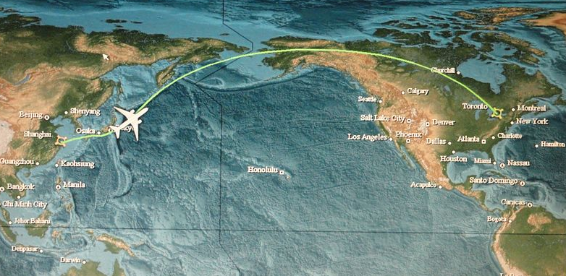
Distance between two points
Uses great circle distance
  Shortest distance over the earth’s surface
Notes:
The shortest points between two points on the earth surface. Great circle distance.
Makes sense to fly over the poles than to fly across the Atlantic at the same longitude.

Slide 9

Finds objects that intersect the current geography object.
Fast but returns lots of false positives
Notes:
Good for for returning results quickly

Slide 10

Finds objects that intersect the current geography object.
Slow but accurate
Notes:
Good for doing precise calculations

Slide 11

Gets the area covered by the geography object.

Slide 12

Adds a region around a geography object
Notes:
Useful when trying to find all the points within X meters to another point or polygon.
DEMO all the functions here

Slide 13

Grid levels
  High = 256 cells = 16 x 16
  Medium = 64 cells = 8 x 8
  Low = 16 cells = 4 x 4
4 layers of nested cells
  HHHH, HHHL, HLLL, HMLL
Cannot have more than 256 cells in a layer
Notes:
Create new spatial index on “California Tracts” table.
Right click “Indexes” and click “New Index”
In General select “Index Type” as “Spatial”
Then click the “Add…” button and select the “Shape” column.
In the “Spatial” section select the tessellation scheme of “Geography Grid”
Leave the levels at Medium for now.

Slide 14

The Primary filter (1st layer) is incredibly important.
  99% or more of the data should be eliminated by the 1st layer.
Secondary filter (subsequent layers) are slow to check.

Slide 15

sp_help_spatial_geography_index
Primary_Filter_Efficiency
  >= 100 is perfect
Internal_Filter_Efficiency
  >= 100 is perfect
Notes:
DEMO the tuning queries
First one should perform well
Second index against the CaliforniaBlocks table should have poor Primary_Filter_Efficency

Slide 16

Cannot include columns
Primary key required
Performance issues on tightly clustered data.
Bad primary filters can kill performance

Slide 17

Common data format
  Census, GIS
Shapefile Uploader
  SQL Server 2008 doesn’t support native Shapefile upload but there are third party tools.
  SQL Server 2008 Spatial Tools at www.SharpGIS.net
Notes:
This is how I imported my data into the project.

Slide 18

No Entity Framework support
  Planned for next version
Reference Microsoft.SQLServer.Types.dll
  Contains SQLGeography and SQLGeometry classes
  Required reference if returning the geography or geometry columns in a result set.

Slide 19

PaulDMendoza.com
  Slides
  Code samples
  Look under “Spatial Data” category
Email: mendoza.paul@gmail.com
Notes:
There is a lot more to spatial data than just this.
Slides
Code samples
Links to the data I used in this demo.
Links to good articles and blogs with more information

